Slide 1
Noodle Doodle with Node.js — Bedang Sen Chandni Vaya

Slide 2
Contents
Why Noodle? 03
Key components used and Architecture 05
Key components used 06
Architecture 07
Demo 08
Building and Deploying it on IBM Cloud 09
References 10

Slide 3
Why Noodle?

Slide 4
IBM should have more fun.
(Learn about IBM cloud and Watson services).

Slide 5
Key components used and Architecture
Key Components Used 06
Architecture 07

Slide 6
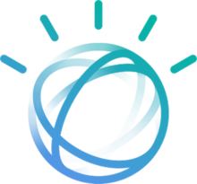
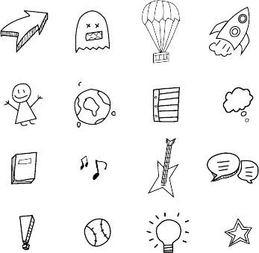


Key components used
Node.js
P5.js
Watson Visual Recognition
Doodle data set

Slide 7

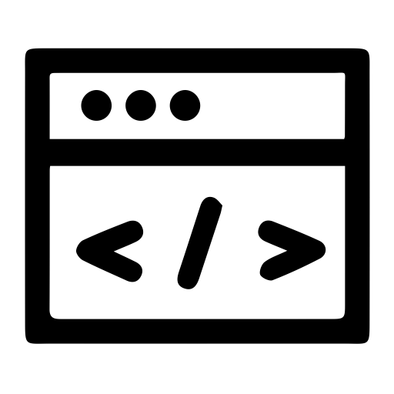


Architecture
USER
PUBLIC CLOUD
1
2
3
USER
WEB UI
NODE JS
WATSON VISUAL RECOGNITION

Slide 8
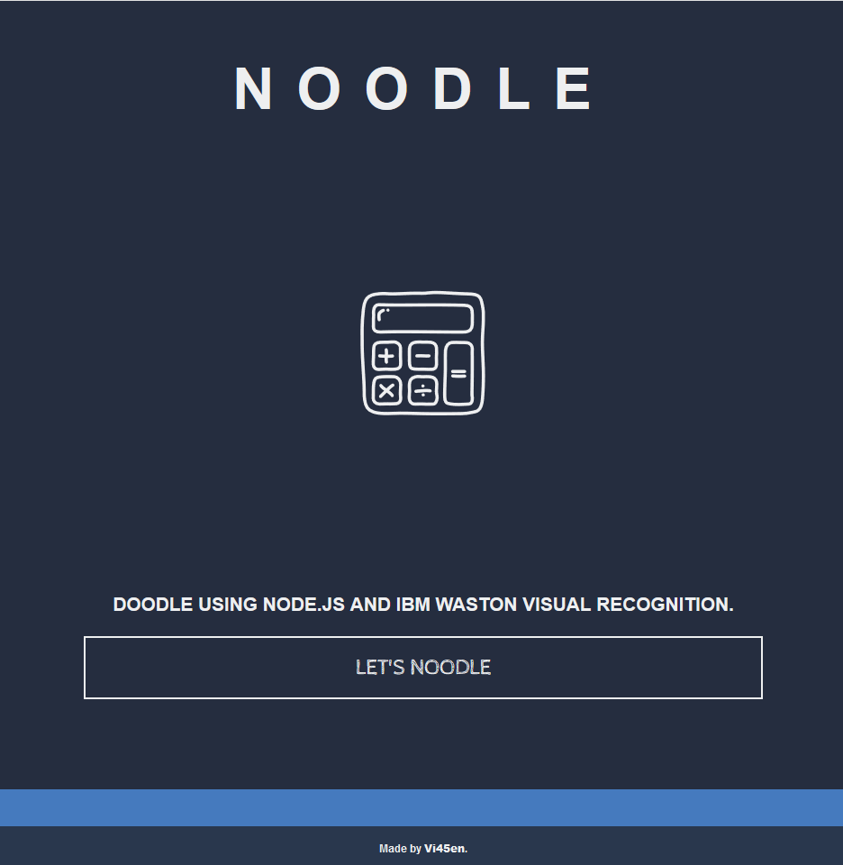
Demo
Noodle
Doodle using noodle by visiting either of the two links:
Noodle.mybluemix.net
Noodledoodle.eu-gb.mybluemix.net
Github Repository
Check out the noodle github repository at the following link:
https://github.com/Vi45en/Noodle

Slide 9
Building and Deploying it on IBM Cloud

Slide 10
References
Doodle Data Set
Doodle Animation for Splashscreen

Slide 11
Thank you.
Bedang Sen
Developer Advocate
Bedang.Sen@ibm.com
+971 55 540 0844
Ibm.com
---
Chandni Vaya
Developer Advocate
Chandni.Vaya@ibm.com
+971 55 367 2387
Ibm.com

